Slide 1

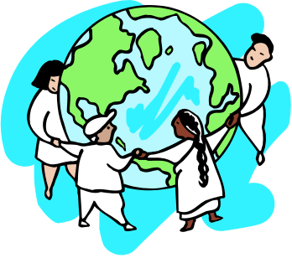
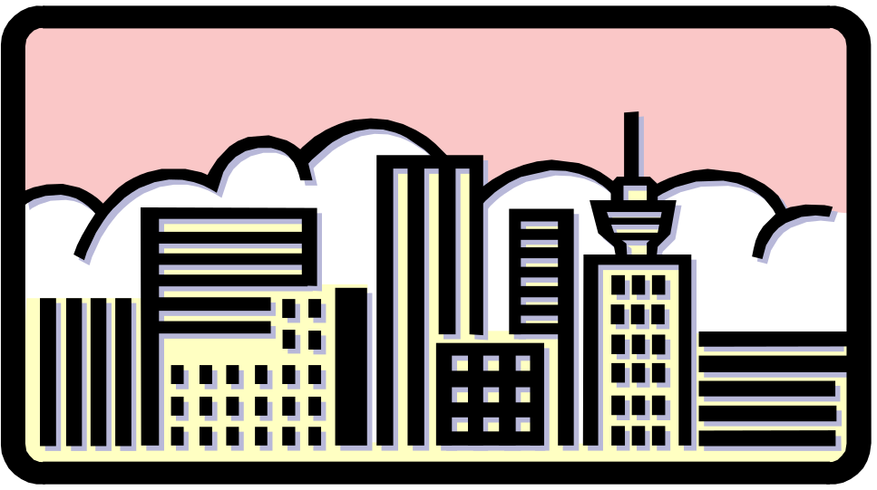
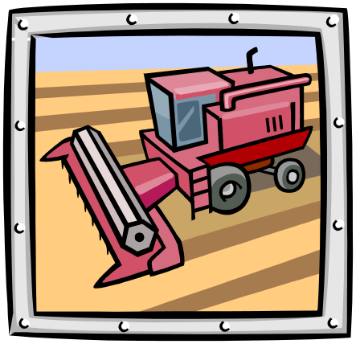
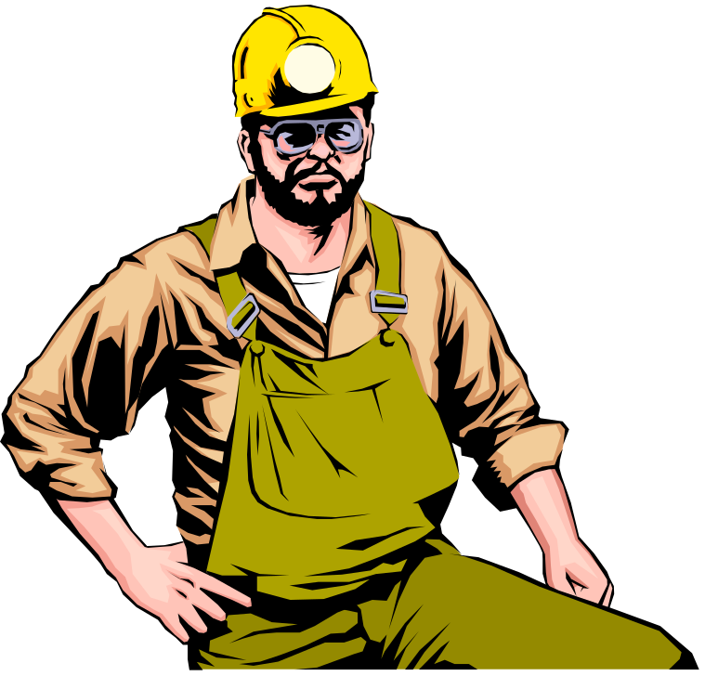
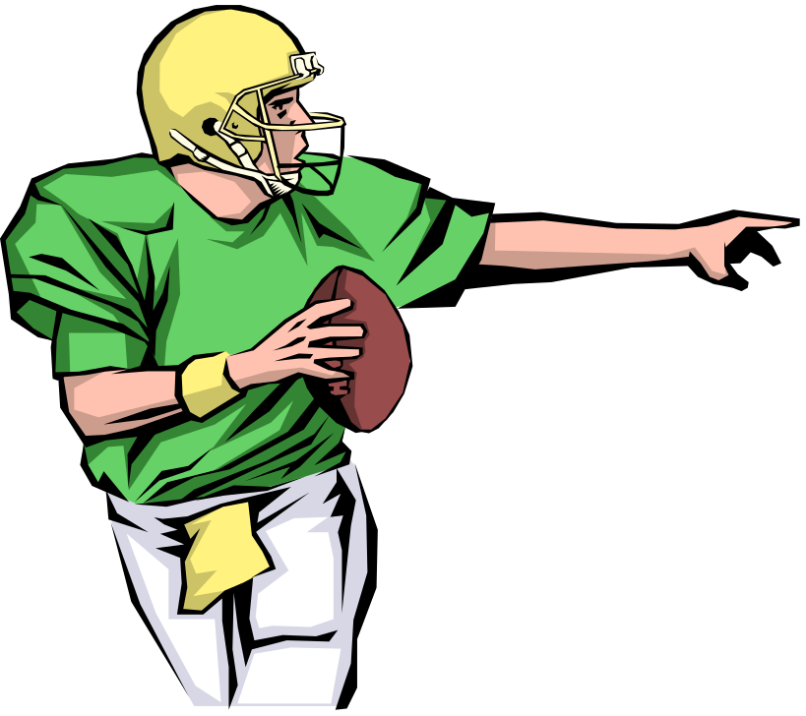
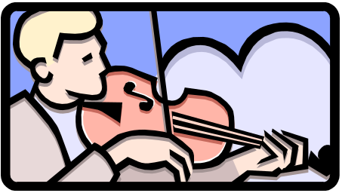
Communities

Slide 2
What is a community?

Slide 3
A COMMUNITY is
a place where people:
  Work
Play
Live

Slide 4
Three types of communities are:
  Urban- a large community with many people and large buildings, a city

Slide 5
Three types of communities are:
  Urban- a large community with many people and large buildings, a city
  Suburb- a medium-sized community near a large city, houses are close together, you may see parks and malls

Slide 6
Three types of communities are:
  Urban- a large community with many people and large buildings, a city
  Suburb- a medium-sized community near a large city, houses are close together, you may see parks and malls
  Rural-a community where houses are far apart, there are a smaller number of people, and you may see farms and forests

Slide 7
We live in communities.
All communities have places where people live.
Homes are different in different communities.
  Urban communities may have high rise apartments and town houses.
  Suburbs may have houses with lawns but with close neighbors. There may also be apartment buildings.
  Rural areas may have houses that are farther apart, on large areas of land with trees.
  What kind of community do you live in?

Slide 8
We work in communities.
All communities have places to work.
Different communities have different jobs.
  Urban communities may have office workers, store clerks, taxi drivers.
  Suburban communities may have factory workers.
  Rural communities may have farmers.
  Can you add some?

Slide 9
We play in communities.
All communities have places to play.
Different communities have different places to play.
  Urban communities may have a large central park or an indoor gym.
  Suburban communities may have neighborhood parks with playgrounds and baseball teams.
  Rural communities may have community parks and fields or county fairs.
  Where do you play?

Slide 10
A COMMUNITY is
a place where people:
  Work
Play
Live

